Slide 1
iFH8 Drone vest add-on
Your anti-personel and low payload drone detector
Sebastian Russo
Javier Peres
Domokos Kertesz
Vilmos Katona

Slide 2
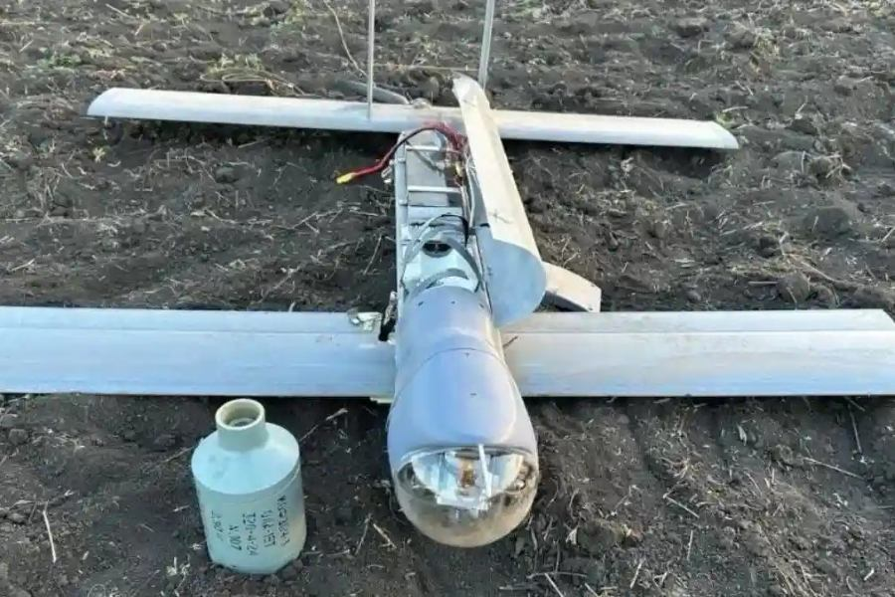
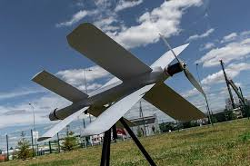
Drones = Danger
- In modern warfare, small commercial drones are a very common threat to dismounted soldiers, specially in open fields.
- A lone soldier that has no early-warning, limited situational awareness, and no passive means of detecting incoming drones is at risk of getting injured or worse.
V2U Loitering munition with a payload ≈ 3kg
Lancet Loitering munition with a payload ≈ 1-3kg

Slide 3
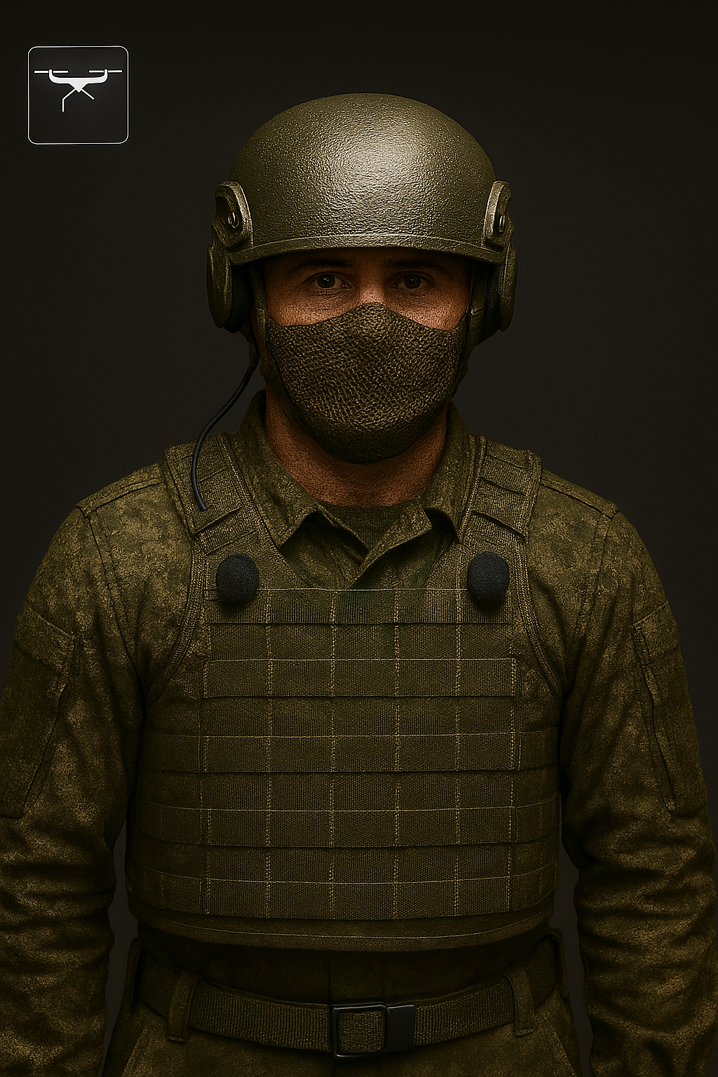
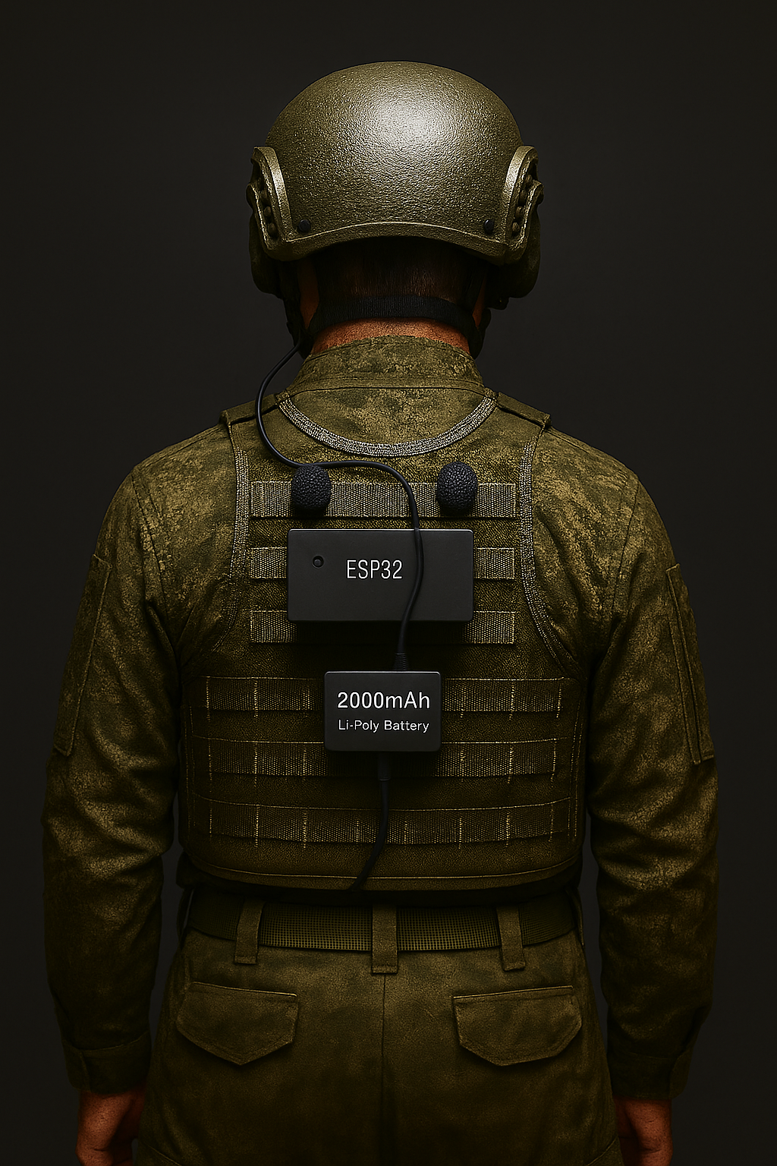
Solution
A lightweight sound-based add-on that identifies drones based on their unique sound profile and using 4 synchronized microphones to pinpoint the exact direction the drone is coming and notifies the soldier through the communication system in their helmets.
(All components are overexaggerated for clarity)

Slide 4
Technicalities
Hardware |  | Software
ESP32-S3 Dev Module (~10 g, €6–15) |  | Audio Capture: 4× I²S microphones (front/back) at 16 kHz
4× MEMS I²S Microphones (~16 g, €6–15) |  | Rolling Buffer: stores 2-4 s of audio for pre-trigger context
2,000 mAh Li-Po Battery (~50 g, €6–15) |  | Auto-Calibration: per-mic gain normalization at startup
Enclosure, Wiring & Mounts (~15–20 g, €5–12) |  | DSP Filters: Digital notch filters + wind-noise suppression
Wind-Noise Reduction Foam (<1 g) |  | Duty-Cycled ML Inference: Energy detector triggers ML when needed only
Total Weight | ~90 g | ML Model: Lightweight audio classifier for drone detection
Total Cost | €25–60 | Output: Alerts to helmet comms with detection & direction
Estimated runtime of around 8 hours of uninterrupted

Slide 5
Product value
Low Cost (€25–60 per unit)
Lightweight System (~90 g total)
Low Cost (€25–60 per unit)
Long Battery Life (~8 hours)
360° Acoustic
Reliable Drone Identification
Low False-Alarm Operation
Automatic Self-Calibration
Environmental Noise Resistance
Efficient, Duty-Cycled Processing
Immediate Soldier Notification
Rugged and Modular Hardware

Slide 6
Limitations

Slide 7
Thank you!!!
Questions?

